Slide 1

Zero Gain vs. Zero Loss: Practical Tales of Enterprise Decision-Making
Amélie Koran

Slide 2
A QUICK ABOUT…(profesSIONAL)
Zero Gain vs. Zero Loss: Practical Tales of Enterprise Decision-Making
Currently Deputy Chief Information Officer for a US Federal Agency sub-component
Private, Public and Academic sector experience
Several Fortune 125 companies, NGOs, Federal agencies and startups including my own
Critical Infrastructure, Entertainment, Technology, Finance, Manufacturing, R&D and Consulting
I’ve done the “full stack here” - development, operations & security…

Slide 3
A QUICK ABOUT…(PERSONAL)
Zero Gain vs. Zero Loss: Practical Tales of Enterprise Decision-Making
Motorcyclist
Triathlon & Snow Skiing
Drummer (sort of)
Toy & Music Collector
…and loves assembling/building LEGO models
That’s my Zen!

Slide 4
Why IS THIS BEING DISCUSSED IN A DEV(SEC)OPS Talk?
Zero Gain vs. Zero Loss: Practical Tales of Enterprise Decision-Making
Demonstrate the value of change to the organization to leadership and the organization
Manage expectations of the impact of the practice to the organization and leadership
Help operations, development and security staff see how leadership view this practice in relation to mission of the organization (and how you can leverage it to your advantage)

Slide 5
Zero Gain vs. Zero Loss: Practical Tales of Enterprise Decision-Making
"[The sum] of two positives is positive, of two negatives negative; of a positive and a negative [the sum] is their difference; if they are equal it is zero. The sum of a negative and zero is negative, [that] of a positive and zero positive, [and that] of two zeros zero.”
Brahmagupta (from “Brāhmasphuṭasiddhānta”) [7th Century]
…essentially, while zero existed as multiple concepts, this is the first time they were a unified theory…

Slide 6
THe CONCEPTS OF ZERO (0)
Zero Gain vs. Zero Loss: Practical Tales of Enterprise Decision-Making
Significance (via the radix point)
1.01 vs. 1.0000001
Magnitude (Positional notation)
10s vs. 100s vs 1,000,000s (and so on)
Absence / Existence
1 vs. 0

Slide 7
Your Leadership / c-suite concepts of zero
Zero Gain vs. Zero Loss: Practical Tales of Enterprise Decision-Making
From Game Theory:
“Zero-Sum” - a mathematical representation of a situation in which each participant's gain or loss of utility is exactly balanced by the losses or gains of the utility of the other participants.
If the total gains of the participants are added up and the total losses are subtracted, they will sum to zero.
Most leadership and executives would like this as a simple score or indicator on a dashboard

Slide 8
Basic Indicators of Failure or Success
Zero Gain vs. Zero Loss: Practical Tales of Enterprise Decision-Making
Daily Question: “What have I done today to make our organization more/less X…?”
Answers are personal to what you do for the organization
Are they measured quantitatively or qualitatively?
What resources were expended to achieve this?
Can the importance of your work be understood and valued by others in your organization?

Slide 9
GAPS OF EXPECTATIONS - REALISTIC and PRACTICAL
Zero Gain vs. Zero Loss: Practical Tales of Enterprise Decision-Making
Budget Justifications
Headcount / Staff
Changes in Business Processes or Operations
Technology Capability / Maturity
Delivery Time
Complexity of Operations

Slide 10
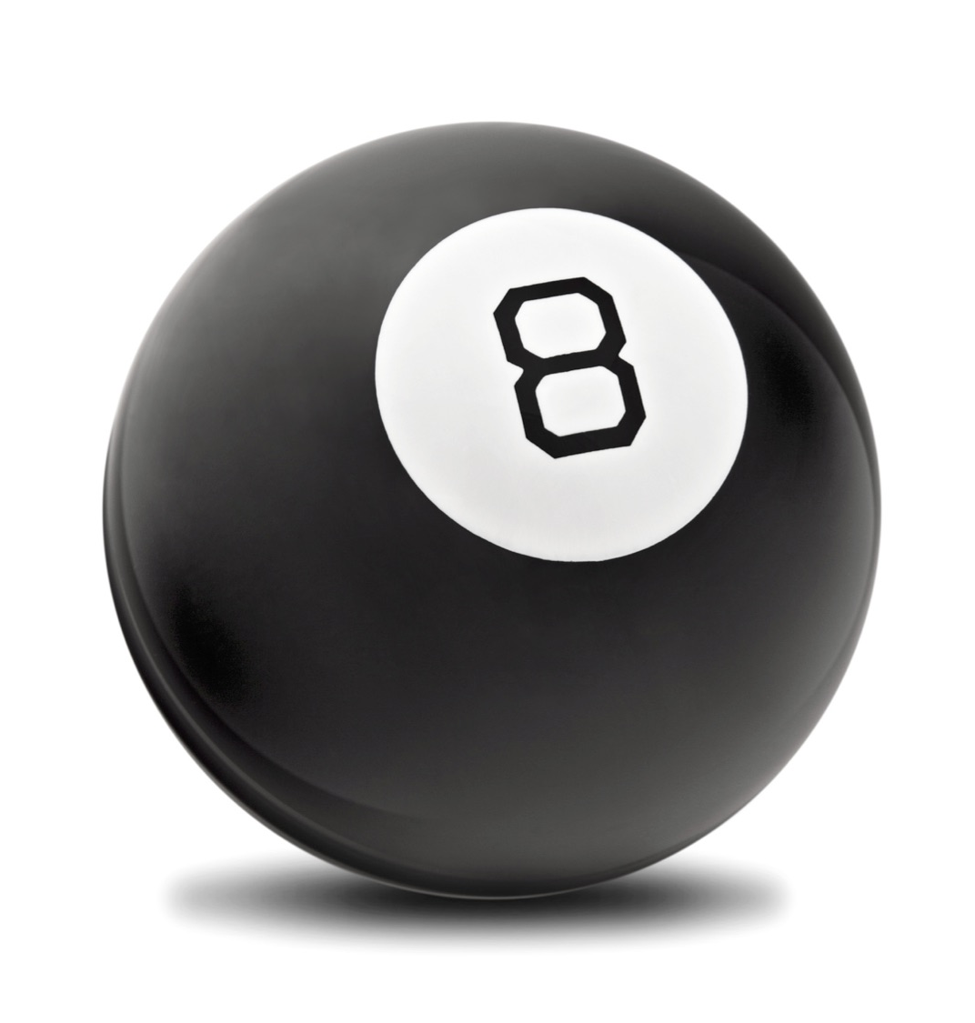
DECISION SUPPORT
Zero Gain vs. Zero Loss: Practical Tales of Enterprise Decision-Making
Informed Question Asking
What do the numbers actually mean?
Do they address the organization’s mission?
What problem is being solved
Altering Strategy (if one exists)
How does this affect a bottom line?
Is there an ROI computation?

Slide 11
So … DevOpS (or DeVSECOPS)
Zero Gain vs. Zero Loss: Practical Tales of Enterprise Decision-Making
What’s my “Play”?
Teaming
Communication & Awareness
Skills Development
Application (to Mission of Business)
Optimization

Slide 12
METAPHORS
Play One :

Slide 13
CONNECT ON A COMMON TOUCHSTONE
Zero Gain vs. Zero Loss: Practical Tales of Enterprise Decision-Making
Why do I have to do ‘X’? (in this case, let’s use “cybersecurity” as a placeholder)
Executives can conceptualize locks on a door, guards at entrances, etc.
Executives can’t conceptualize anti-virus, network monitoring, etc.
Use a metaphor (or two) to bridge the gap
“Health Insurance” coverage is one that tends to work
Actuarial models, something touched on in “B-School” is the spin
Risks are complex and diversified, but easier to demonstrate physical manifestations rather than logical or digital representations

Slide 14
Why DOES THIS WORK?
Zero Gain vs. Zero Loss: Practical Tales of Enterprise Decision-Making
You don’t talk tech, you talk in terms of something they are familiar with
Risk, as a concept, is borne out of the financial industry
You save money (shooting for a net “zero” loss) as a goal, part of a planning process
Understanding of spending a “little” to hedge against a “greater” loss
Magnitude of expense versus return (i.e. $100 for 80%, $20 for 10%)
Inoculate against a high probability event, but also catch smaller less probable events by a wider coverage of protection

Slide 15
PARTICPATION
Play Two

Slide 16
THE VALUE OF A SEAT AT THE TABLE
Zero Gain vs. Zero Loss: Practical Tales of Enterprise Decision-MakinG
Table Top Exercises and Root Cause Analysis
Design Sprints
Open Brainstorming and Scenario-Based discussions
Strategy and Planning Sessions
Budget Planning and Review
Brown-Bags / Lunch and Learns

Slide 17
OUTCOMES
Zero Gain vs. Zero Loss: Practical Tales of Enterprise Decision-MakinG
Provides a more visceral connection between staff, goals and mission/operations
Communication barriers are lessened, empathy is created, awareness is enabled

Slide 18
CONCEPTUALIZATION
PLAY Three

Slide 19
Define EVERYTHING
Zero Gain vs. Zero Loss: Practical Tales of Enterprise Decision-MakinG
Working from a common lexicon
Agreement on what things mean
Framing the discussion, bounding and setting goals
Referential and clarity
Enables knowledge transfer
Allows for others to participate due to documentation

Slide 20

CLEAR COMMUNICATION
Zero Gain vs. Zero Loss: Practical Tales of Enterprise Decision-Making
Reduces stress & anxiety
Engenders trust
Reduces questions (and thus frees up resources)
“Force multiplier” (no knowledge embargoes)
Reuse is possible, rework is reduced
Good jumping off point

Slide 21
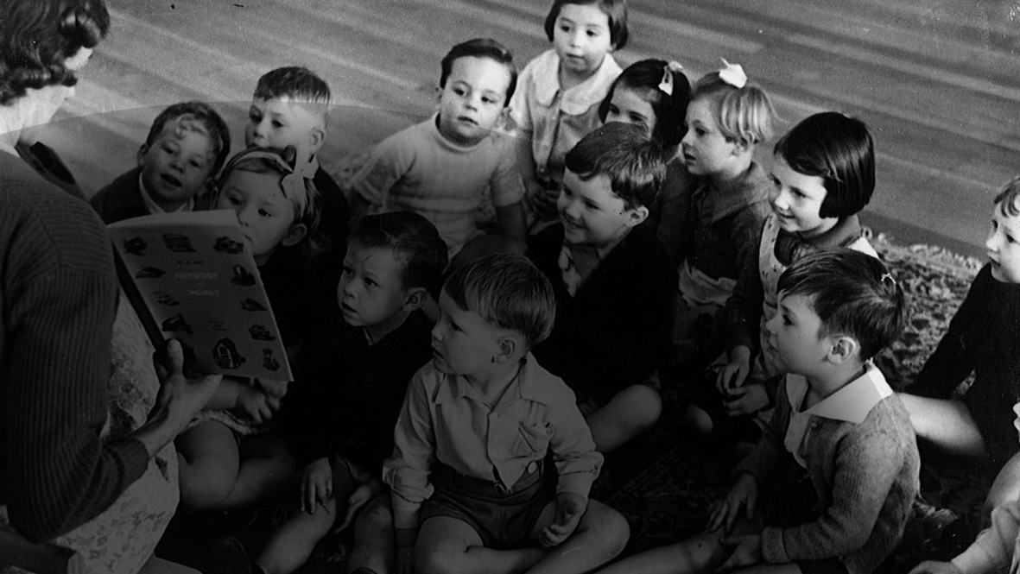
Story TIME
And now…

Slide 22
Why DO YOU WANT A DASHBOARD?
Zero Gain vs. Zero Loss: Practical Tales of Enterprise Decision-Making
Ask what is the question they want answered.
Qualitative vs. Quantitative
What decision is it intended to support?
Does it actually help solve a problem or issue?
Is what is presented, done so in a manner that can be understood and acted upon?
If presented as a “single number” or “color”, what does it mean?

Slide 23
What SPArked This Talk?
Zero Gain vs. Zero Loss: Practical Tales of Enterprise Decision-Making
Brian Krebs article July, 2018 : “Hackers Breached Virginia Bank Twice in Eight Months, Stole $2.4M” (https://bit.ly/2LMpiP0)
Note the key item “twice” - they had insurance and tried to claim a loss
Echoes of “out of sight, out of mind” for correcting business processes
Leadership would see it as more cost effective to attempt collect and fight rather than fix original flaws
Play the odds of a second occurrence happening and not uncovering possible negligence

Slide 24
USING EXPERIENTIAL LEARNING FOR BEHAVIOR CHANGE
Zero Gain vs. Zero Loss: Practical Tales of Enterprise Decision-Making
Expectation of a metaphorical “black swan” event (such as a breach) - “near zero probability” mindset
Not rationalized properly, and suffering from a hindsight bias
It is a multifaceted phenomenon that can affect different stages of designs, processes, contexts, and situations. May cause memory distortion, where the recollection and reconstruction of content can lead to false theoretical outcomes.
The expectation of a “near zero” prevents conceptualization, and reduces participation in planning and thinking

Slide 25
NEAR-ZERO ISN’T ZERO - RATIONALIZING EVENTS IN DEVSECOPS
Zero Gain vs. Zero Loss: Practical Tales of Enterprise Decision-Making
Aim to reduce user errors - utilize a good UX/UI practice in software design
Automate testing and evaluation - identify errors before deployment
Don’t deploy directly to production - invest in a development and test environment, enhances overall resiliency
For major issues/incidents, perform root cause analyses - iteration in Agile literally should embody this
Include the proper team members - if you don’t include staff from the DevSecOps triad, you’re not doing DevSecOps (especially for organization in transition)

Slide 26
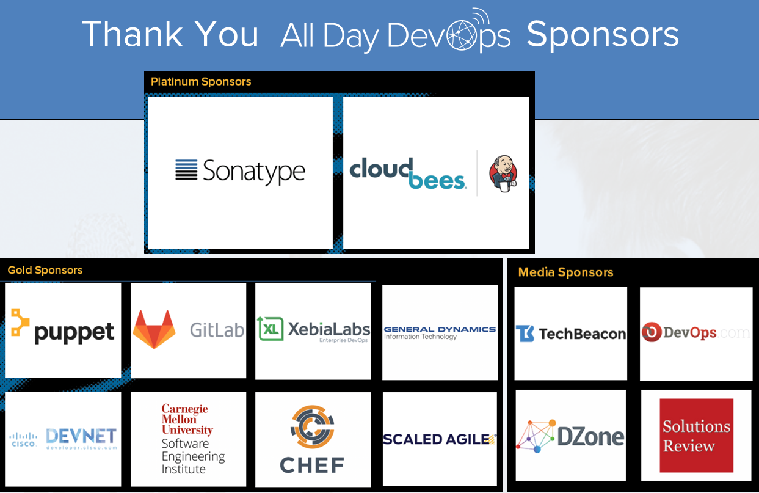

Slide 27
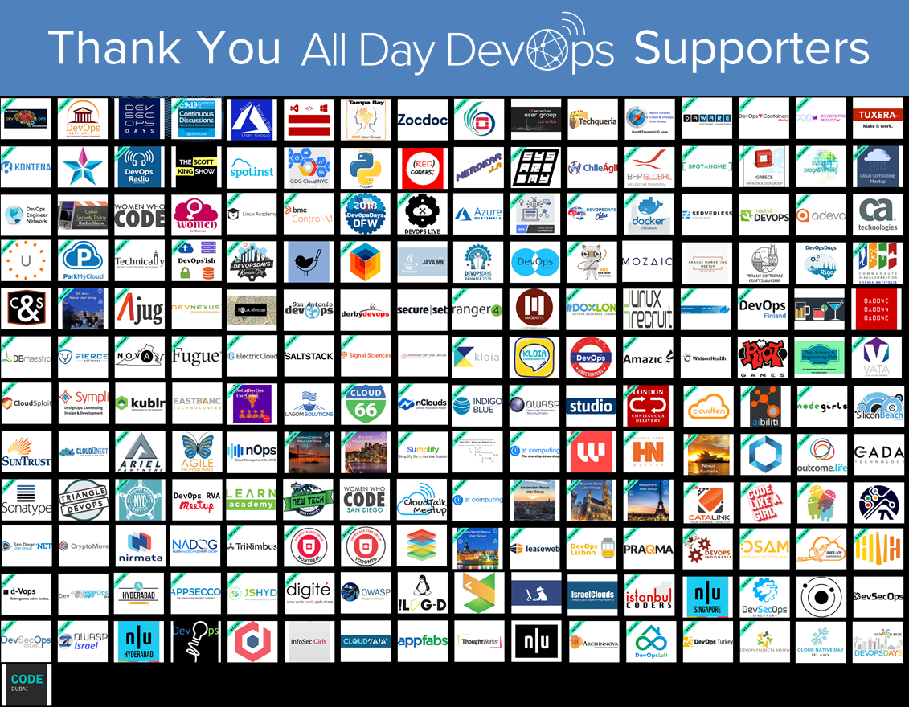

Slide 28

Q&A TIME / DISCUSSION
bit.ly/addo-slack

